Slide 1

Deep Learning in Physical Layer
Deep Learning-Based Detector for OFDM-IM
Department of Electronic Communication Engineering
Liu Yu-Chen
0840042
T. V. Luong, Y. Ko, N. A. Vien, D. H. N. Nguyen and M. Matthaiou, "Deep Learning-Based Detector for OFDM-IM," in IEEE Wireless Communications Letters, vol. 8, no. 4, pp. 1159-1162, Aug. 2019.

Slide 2
Background (1)

Slide 3
Related Work (1)

Slide 4
System Model

Slide 5
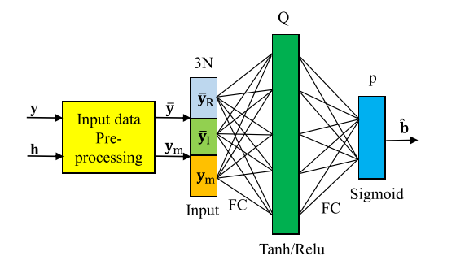

Structure of DeepIM
N: subcarrier number
Q: hidden layer unit number
p: output number (bit per symbol)
y: received signal
h: channel state information

Slide 6
Simulation Result (1)
Simulation env and support:
Python 3.6.3
Tensorflow 1.15.0
Numpy 1.17.4
Scipy 1.3.3
GPU: nvida 1060/6G
Google Colab: https://colab.research.google.com/drive/1cba8mNnZmB4QIetwnEW6225-UE0TavGQ
Github:

Slide 7

Thank You !!!

